Slide 1


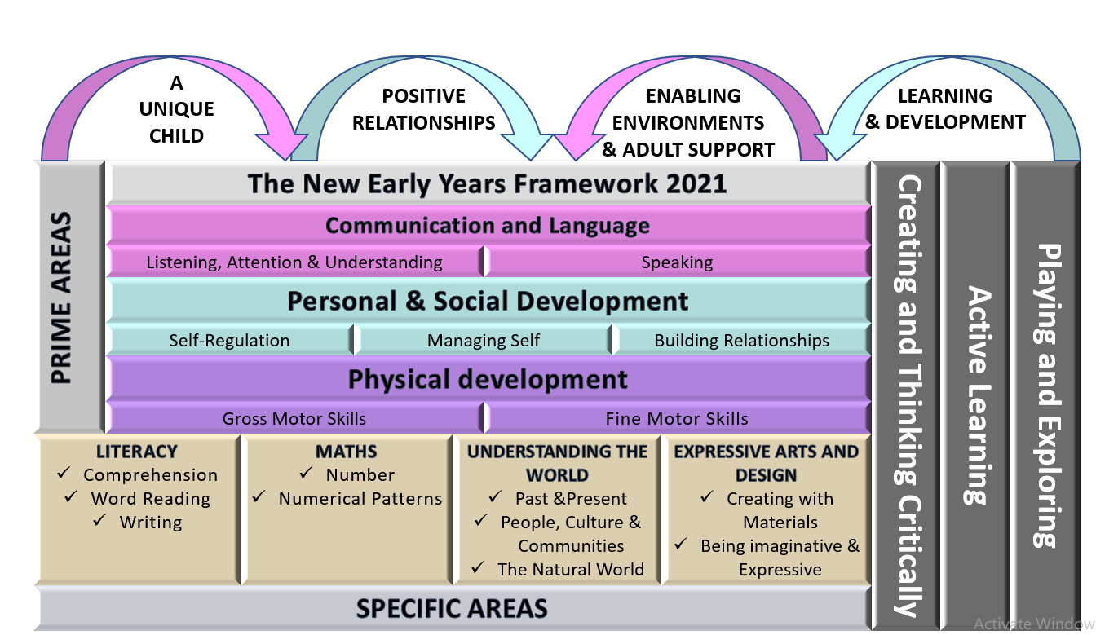
Reception Long Term Plan 25-26

Slide 2

Reception Long Term Plan 25-26
 | Autumn 1 | Autumn 2 | Spring 1 | Spring 2 | Summer 1 | Summer 2
General Themes | All About me! | Terrific Tales! | Amazing Animals! | Come Outside! | Ticket to Ride! | Fun at the seaside!
COMMUNICATION AND LANGUAGE | Talking to friends Sharing facts about self, experiences & goals | Responding to stories & retelling them Following instructions Taking part in discussion | Answering how and why questions Inventing own verbal stories | Sustained focus when listening Giving simple explanations | Describing events & stories in detail | Multi-step instructions
 | On going work: talking & discussion times, sharing stories & songs, developing vocabulary, developing concentration & listening,, show & tell, NELI intervention as appropriate
PERSONAL, SOCIAL & EMOTIONAL DEVELOPMENT | MMR- Beginning and belonging Class Rules and Routines Supporting children to build relationships | MMR- My emotions MMR- Family and friends Getting on and falling out How to deal with different emotions – colour monster Self - Confidence Build constructive and respectful relationships. | Citizenship- identity and diversity Good to be me Learning about qualities , similarities & differences Identify and moderate their own feelings socially and emotionally | Citizenship- Me and my world Relationships What makes a good friend? Healthy me Looking after pets Looking After our Planet | Healthy and safer lifestyles- My body and growing up Looking after others Friendships Dreams and Goals | Healthy and safer lifestyles- Keeping Safe Taking part in sports day - Winning and losing How I’ve changed - Look how far I've come! Transition for Y1
PHYSICAL DEVELOPMENT | Threading, weaving, playdough, building, construction Manipulate objects with good fine motor skills Use tools to effect changes to materials Cutting along lines Develop pencil grip Teach and model correct letter formation | Threading, weaving, playdough, building, construction Form recognizable letters - most correctly formed Handle tools, objects, construction and malleable materials with increasing control Cutting along a curved line, like a circle Zip clothing | Threading, weaving, playdough, building, construction Develop pencil grip and letter formation continually (write on the line) Increasingly precise use of tools & materials, including smaller items Draw & cut more complex shapes Button clothing
Gross motor | Cooperation games e.g. parachute games Ball skills Outdoor large loose part & trim trail to explore ways of moving, balance, coordination Moving to music (dance) Gymnastics – balance, outdoor & indoor equipment Changing for PE & when using costumes for role play PE sessions following Complete PE Scheme

Slide 3

Reception Long Term Plan 25-26
 | Autumn 1 | Autumn 2 | Spring 1 | Spring 2 | Summer 1 | Summer 2
General Themes | All About me! | Terrific Tales! | Amazing Animals! | Come Outside! | Ticket to Ride! | Fun at the seaside!
Literacy | Joining in with rhymes and stories Reading environmental print Recognizing initial sounds Exploring dominant hand & tripod grip Mark making Name writing Lists Writing initial sounds Nursery Rhymes - label characters RWI Phonics Drawing Club: The Colour Monster (Feelings) Aldo (Feelings) Farmer Ham (Harvest) | Retell stories Christmas letters/lists Using story maps and orally retelling stories Reading CVC words Name writing Labelling using initial sounds Writing CVC labels Story scribing Story sequencing Texts as a Stimulus: The Little Red Hen- sequence the story/add speech bubbles The Three Billy Goats Gruff - create a wanted poster to catch the troll RWI Phonics | Making up stories - record stories through drawing/mark making Read simple captions and phrases Read a few common exception words matched to RWI Writing tricky words (red) such as I, me, my, to, the Writing CVC, CVCC, CCVC words. Create a story board/map Texts as a Stimulus: Lost & Found & Owl Babies - writing CVC words & simple sentences Handa’s Surprise - Retell the story in own words/write new version RWI Phonics | Information leaflets about animals in the garden/plants and growing Re-read books to build confidence, fluency, understanding & enjoyment Hungry Caterpillar -describe foods / adjectives Healthy Food – My Menu / Bean Diary Writing captions & simple sentences Labels and captions – life cycles Recount – A trip to the park Texts as a Stimulus: Jack and the Bean stalk – retell parts of the story / repeated refrains / speech bubbles RWI Phonics | Stories from other cultures and traditions Retell a story with actions and / or picture prompts as part of a group - Use story language when acting out a narrative Writing phonetically plausible attempts at words Beginning to use finger spaces Form lower-case and capital letters correctly Texts as a Stimulus: Mr Gumpy’s Outing - report about the animals falling into the water RWI Phonics | Listen to stories, accurately anticipating key events & respond to what they hear with relevant comments, questions and reactions. Make predictions Understands fiction vs non-fiction. Can show the front cover, back cover, spine, blurb, illustration, illustrator, author and title. Write a postcard / diary writing My Holiday – recount writing sentences using a range of tricky words that are spelt correctly. Beginning to use full stops, capital letters and finger spaces. Using familiar texts as a model for writing own stories. Texts as a Stimulus: Big Blue Whale - Write facts about whales RWI Phonics

Slide 4
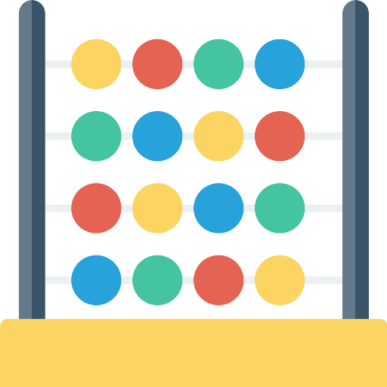
Reception Long Term Plan 25-26
 | Autumn 1 | Autumn 2 | Spring 1 | Spring 2 | Summer 1 | Summer 2
General Themes | All About me! | Terrific Tales! | Amazing Animals | Come Outside! | Ticket To Ride! | Fun At The Seaside!
Maths | Maths Mastery Programme White Rose Maths Match and sort, Compare amounts, Compare size, mass & capacity Exploring pattern | Maths Mastery Programme White Rose Maths Representing, comparing and composition of numbers Circles and triangles Shapes with 4 sides Positional language Time | Maths Mastery Programme White Rose Maths Comparing Numbers & Composition Compare mass Compare capacity Making Pairs Combining 2 groups Length & Height Time | Maths Mastery Programme White Rose Maths Comparing Numbers & Composition Bonds to 10, 3d-shape Pattern | Maths Mastery Programme White Rose Maths Building numbers beyond 10 Counting Patterns beyond 10 Spatial reasoning Match, rotate, manipulate Adding More Taking Away | Maths Mastery Programme White Rose Maths Doubling, sharing and grouping Even and odd Spatial reasoning Visualise and build Deepening understanding of patterns and relationships,

Slide 5

Reception Long Term Plan 25-26
 | Autumn 1 | Autumn 2 | Spring 1 | Spring 2 | Summer 1 | Summer 2
General Themes | All About me! | Terrific Tales! | Amazing Animals! | Come Outside! | Ticket to Ride! | Fun at the seaside!
Understanding the world | Exploring family & people who matter to us Sharing own family routines and traditions Wider community – who helps us - occupations Navigating around our classroom and outdoor areas. Create treasure hunts to find places/ objects within our learning environment How have you changed since a baby? Forest school Geography Day- Where do I live? Science Day-All about me Kapow RE- What is the Harvest Festival? What makes us special? | Talk about what they have done with their families during Christmas’ in the past Differences in Christmas around the world and in the past Share different cultures versions of famous fairy tales Forest school History Day- Castles Science Day- healthy living, oral hygiene Kapow RE- What is Hanukah? What are special times? | Comparing habitats around the world Using a world map How we can take care of animals Nocturnal Animals Observations of animals Use stories to explore a different country How zoos have changed over the years Forest school Geography Day- What is an island? Science Day- Mini beasts Zoo lab visit Kapow RE- What is Shrove Tuesday? | Trip to our local park – our journey Recycling & care of our environment Observations of plants and animals Weather, culture, clothing, housing. Change in living things – plants, weather, seasons, Building a ‘Bug Hotel’ Forest school Science Day- Growing Kapow RE- What is Holi? What is Ramadan? | How they get to school and what mode of transport they use. Introduce the children to a range of transport and where they can be found. Look at the difference between transport in this country and one other country. Encourage the children to make simple comparisons. Use bee-bots on simple maps. Encourage the children to use navigational language Can children talk about their homes and what there is to do near their homes? Environments – features of local environment Introduce children to significant figures who have been to space and begin to understand that these events happened before they were born Science Day- Flaoting and sinking Geography Day- Hot and cold countries Kapow RE- What makes the world special? | To understand where dinosaurs are now and begin to understand that they were alive a very long time ago. Learn about what a palaeontologist is and how they explore really old artefacts. Introduce Mary Anning as the first female to find a fossil. Materials: Floating / Sinking – boat building Metallic / non-metallic objects Seasides long ago Share non-fiction texts that offer an insight into contrasting environments Listen to how children communicate their understanding of their own environment and contrasting environments through conversation and in play History Day- Dinosaurs Kapow RE- Why are some stories special?

Slide 6


Reception Long Term Plan 25-26
 | Autumn 1 | Autumn 2 | Spring 1 | Spring 2 | Summer 1 | Summer 2
General Themes | All About me! | Terrific Tales! | Amazing Animals! | Come Outside! | Ticket to Ride! | Fun at the seaside!
Expressive Arts and Design . | Joining in with & learning songs, listening to &responding/moving to music, creating own sounds & copying beats in music, role play, small world play, loose parts play, junk modelling, props & puppets
Expressive Arts and Design Painting, 3D modelling, messy play, collage, cutting, drama, role play, threading, moving to music, clay sculptures, following music patterns with instruments, singing songs linked to topics, making instruments, percussion. Children to produce a piece of art work each half term to be displayed for ‘Celebration wall’ for school / parents to show how drawings have developed - lots of links to Fine Motor Skills. Children to explain their work to others. Children will have opportunities to learn and perform songs, nursery rhymes and poetry linked to their work / interests and passions. | Starting school collage Self-portraits Superhero masks Design & make emotion monsters Kapow art- Drawing Marvellous Marks Kapow art-Nature wreaths Kapow music- Exploring Sounds | Make houses for the three little pigs and bridges for the Three Billy Goats Castle models Christmas cards Clay Divas Kapow art- Paint my World Kapow art- Salt dough decorations Kapow Music- Celebration Music (Christmas lessons and Hanukah lessons) Musical stories | Rousseau’s Tiger / animal prints Designing homes for hibernating animals Clay hedgehogs Animal masks Shadow Puppets Making lanterns & Chinese writing Kapow art- Sculptre and 3D creation station Kapow art- threaded snowflakes Kapow Music- Music and movement | Design & make scarecrows Pastel drawings, printing, patterns on Easter eggs, Flowers – pastels & water colours, collage Mother’s Day crafts Easter crafts Home Corner role play Natural art Spring showcase Kapow art- Let's get crafty Kapow art- egg threading | Design and make rocket & things they may need in space Junk modelling, houses, bridges boats and transport Exploration of other countries – dressing up in different costumes – role play Creating outer space pictures Kapow art- petal suncatchers Kapow music- Transport | Sand pictures Lighthouse designs Paper plate jellyfish Salt dough fossils Water pictures, collage, shading by adding black or white Colour mixing – underwater pictures. Father’s Day Crafts Kapow art- sand art Kapow Music- Big Band

Slide 7
Reception Long Term Plan 25-26
Early Learning Goals – for the end of the year - Holistic / best fit Judgement! | Early Learning Goals | Autumn 2 | Spring 1 | Spring 2 | Summer 1 | Summer 2
Communication and Language | Personal, social, emotional development | Physical Development | Literacy | Maths | Understanding the World | Expressive arts and design
ELG: Listening, Attention and Understanding Listen attentively and respond to what they hear with relevant questions, comments and actions when being read to and during whole class discussions and small group interactions Make comments about what they have heard and ask questions to clarify their understanding Hold conversation when engaged in back-and-forth exchanges with their teacher and peers. | ELG: Self-Regulation Show an understanding of their own feelings and those of others and begin to regulate their behaviour accordingly. Set and work towards simple goals, being able to wait for what they want and control their immediate impulses when appropriate. Give focused attention to what the teacher says, responding appropriately even when engaged in activity, and show an ability to follow instructions involving several ideas or actions. | ELG: Gross Motor Skills Negotiate space and obstacles safely, with consideration for themselves and others. Demonstrate strength, balance and coordination when playing. Move energetically, such as running, jumping, dancing, hopping, skipping and climbing. | ELG: Comprehension Demonstrate understanding of what has been read to them by retelling stories and narratives using their own words and recently introduced vocabulary. Anticipate – where appropriate – key events in stories. Use and understand recently introduced vocabulary during discussions about stories, non-fiction, rhymes and poems and during role-play. ELG: Word Reading Say a sound for each letter in the alphabet and at least 10 digraphs. Read words consistent with their phonic knowledge by sound-blending. Read aloud simple sentences and books that are consistent with their phonic knowledge, including some common exception words. | ELG: Number Have a deep understanding of number to 10, including the composition of each number; Subitise (recognise quantities without counting) up to 5; - Automatically recall (without reference to rhymes, counting or other aids) number bonds up to 5 (including subtraction facts) and some number bonds to 10, including double facts. | ELG: Past and Present Talk about the lives of the people around them and their roles in society. Know some similarities and differences between things in the past and now, drawing on their experiences and what has been read in class. Understand the past through settings, characters and events encountered in books read in class and storytelling. ELG: People, Culture and Communities Describe their immediate environment using knowledge from observation, discussion, stories, non-fiction texts and maps. Know some similarities and differences between different religious and cultural communities in this country, drawing on their experiences and what has been read in class. | ELG: Creating with Materials Safely use and explore a variety of materials, tools and techniques, experimenting with colour, design, texture, form and function. Share their creations, explaining the process they have used; - Make use of props and materials when role playing characters in narratives and stories.

Slide 8
Reception Long Term Plan 25-26
Early Learning Goals – for the end of the year - Holistic / best fit Judgement! (continued) | Early Learning Goals | Autumn 2 | Spring 1 | Spring 2 | Summer 1 | Summer 2
Communication and Language | Personal, social, emotional development | Physical Development | Literacy | Maths | Understanding the World | Expressive arts and design
ELG: Speaking Participate in small group, class and one-to-one discussions, offering their own ideas, using recently introduced vocabulary. Offer explanations for why things might happen, making use of recently introduced vocabulary from stories, non-fiction, rhymes and poems when appropriate. Express their ideas and feelings about their experiences using full sentences, including use of past, present and future tenses and making use of conjunctions, with modelling and support from their teacher. | ELG: Managing Self Be confident to try new activities and show independence, resilience and perseverance in the face of challenge. Explain the reasons for rules, know right from wrong and try to behave accordingly. Manage their own basic hygiene and personal needs, including dressing, going to the toilet and understanding the importance of healthy food choices. ELG: Building Relationships Work and play cooperatively and take turns with others. Form positive attachments to adults and friendships with peers;. Show sensitivity to their own and to others’ needs. | ELG: Fine Motor Skills Hold a pencil effectively in preparation for fluent writing – using the tripod grip in almost all cases. Use a range of small tools, including scissors, paint brushes and cutlery. Begin to show accuracy and care when drawing. | ELG: Writing Write recognisable letters, most of which are correctly formed. Spell words by identifying sounds in them and representing the sounds with a letter or letters. Write simple phrases and sentences that can be read by others. | ELG: Numerical Patterns Verbally count beyond 20, recognising the pattern of the counting system; - Compare quantities up to 10 in different contexts, recognising when one quantity is greater than, less than or the same as the other quantity. Explore and represent patterns within numbers up to 10, including evens and odds, double facts and how quantities can be distributed equally. | Explain some similarities and differences between life in this country and life in other countries, drawing on knowledge from stories, non-fiction texts and – when appropriate – maps. ELG: The Natural World Explore the natural world around them, making observations and drawing pictures of animals and plants. Know some similarities and differences between the natural world around them and contrasting environments, drawing on their experiences and what has been read in class. Understand some important processes and changes in the natural world around them, including the seasons and changing states of matter. | ELG: Being Imaginative and Expressive Invent, adapt and recount narratives and stories with peers and their teacher. Sing a range of well-known nursery rhymes and songs; Perform songs, rhymes, poems and stories with others, and – when appropriate – try to move in time with music.

